Slide 1


SRI RAMAKRISHNA ENGINEERING COLLEGE
[Educational Service:SNR Sons Charitable Trust][Autonomus Institution, Accredited by NAAC with ‘A’ Grade]
[Approved by AICTE and Permanently Affiliated to Anna University, Chennai]
[ISO 9001-2008 Certified and All Eligible Programmes Accredited by NBA]
Vattamalaipalayam, N.G.G.O, Colony Post, Coimbatore-641022.
PALM PATTERN RECOGNITION USING FEATURE DETECTION
Presented by, Guided by,
Jayamathan.S(1302038) Ms V.Sangeetha
Kishorr.S.R(1302046) AP(Sr.G)/ECE
Dheena Dhayalan.T(1302058)

Slide 2
ABSTRACT
The texture of the palm pattern of different individuals has been proven to be distinctive even among identical twins. Initially the palm images are preprocessed to select the region of interest for palm pattern extraction.
Scale invariant feature transform algorithm is used to compare the images and recognize the pattern.
To effective person identification palm pattern recognition implemented by feature detection.

Slide 3
Specifications
Open CV software – 2.4.10
Python IDE – 2.7

Slide 4
BLOCK DIAGRAM
Input palm pattern image
BGR to Gray scale conversion
Key Point Detection
ROI Selection
Reference Samples
Scale Invariant feature transform
Feature Vectors
Distance Measurement
Recognition

Slide 5
Explanation :
Input palm pattern images are extracted from human hands
Extracted images are converted from BGR to grayscale images
From those images, preferred ROI selection is performed
Key points are detected from that ROI area
Then Scale invariant feature transform algorithm is applied
Then reference samples and target images are compared using distance measurement method
From those results, recognition is performed

Slide 6
ALGORITHM
Start
Initially convert BGR image to grayscale image
Identify the region of interest
Detect and mark the key points in the ROI

Slide 7
Sort the key points based on rows and columns
Compare the images using distance measurement
Draw the lines for matching key points
Stop

Slide 8
PROGRAM
The code used for our project is given as hyperlink
Palm pattern recognition using SIFT algorithm
Palm pattern recognition using ORB algorithm
VIDEO
Palm pattern recognition using feature detection

Slide 9
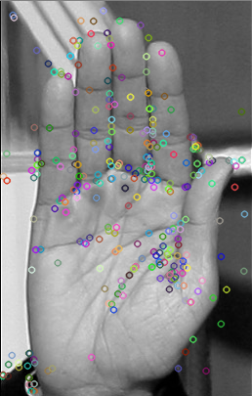
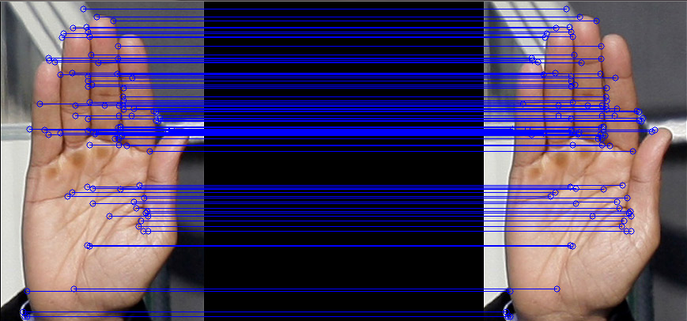
EXPERIMENTAL RESULTS
Key points Detection
Image comparison based on key points matching

Slide 10
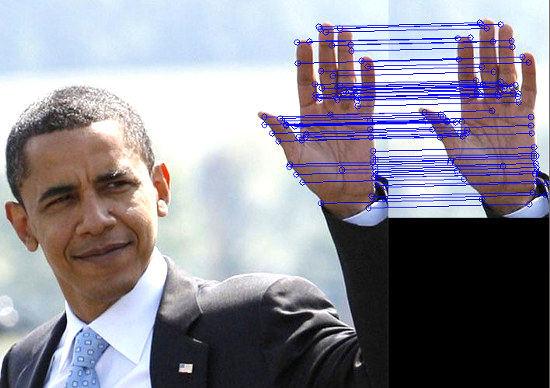
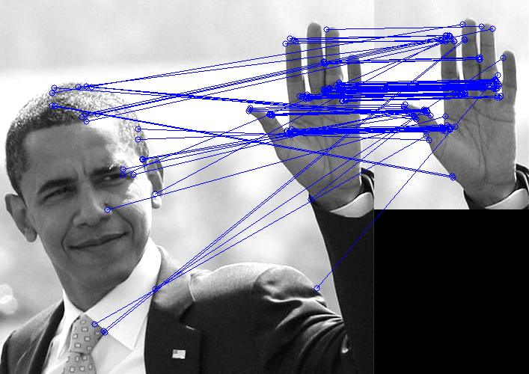
EXPERIMENTAL RESULTS
SIFT Experimental Result
ORB Experimental Result

Slide 11
Analysis
Existing methods and algorithms results in negative effects when more key points are taken for analysis
Also oil, moisture on hand will also affects the accuracy
SIFT algorithm produces high accuracy even when more key points are taken and its results does not alter even with moisture and oil surfaces

Slide 12
COMPARISON
EXISTING
Oriented fast and rotated BRIEF transform
Oil on the fingers, moisture and dirt have negative effect on recognition performance
Accuracy is affected when more keypoints are taken for consideration
PROPOSED
Scale Invariant Feature Transform
Oil on the fingers, moisture and dirt will not effect on recognition performance
Accuracy is maintained even when more keypoints are considered

Slide 13
CONCLUSION
Numerous studies have revealed that SIFT algorithm applied on palm pattern image has high accuracy due to its higher texture representation ability. But it also has high computational burden. Future work includes that while operating on real time images, some extended methods are implied to reduce computational burden for faster processing.

Slide 14
Reference
[1] Sahar Bayoumi, R. M. Bolle, and S. Pankanti, Biometrics: Personal Identification Networked Society. Norwell, MA, USA: Kluwer, 1999.
[2]Y. Hao, S. Zhao, and J. Liu, “Local derivative pattern versus local binary pattern: Face recognition with high-order local pattern descriptor,” IEEE Trans. Image Process., vol. 19, no. 2, pp. 533–544,Feb. 2010.
[3]Y. Zhou and A. Kumar, “Human identification using palm-vein images,” IEEE Trans. Inf. Forensics Security, vol. 6, no. 4, pp. 1259–1274,Dec. 2011.
[4]Z. Khan, A. Mian, and Y. Hu, “Contour code: Robust and efficient multispectral palm print encoding for human recognition,” in Proc. IEEEInt. Conf. Comput. Vis., Nov. 2011, pp. 1935–1942.
[5]L. Zhang, L. Zhang, and D. Zhang, “Finger-knuckle-print verification based on band-limited phase-only correlation,” in Proc. 13th Int. Conf.Comput. Anal. Images Patterns, 2009, pp. 141–148.

Slide 15
THANK YOU

